Slide 1
ALLFTD New Coordinator Training

Slide 2
Training Overview
Collection Overview
Kit Requests
Specimen Labels
Sample Forms
Sample Collection and Processing
Sample Shipping
NCRAD Website
Questions?

Slide 3
ALLFTD Study Specimens
 | RAVE CYCLE (ALL)
DNA (BUFFY COAT) | X
PLASMA | X
PBMC | X
SERUM | X
RNA | X
CSF* | X
*Select subjects to donate CSF

Slide 4
ALLFTD Kit Request Module
http://kits.iu.edu/allftd

Slide 5
When to Order Kits
Each site will be responsible for ordering kits (labels included) and maintaining a supply on site for scheduled participants
Allow a minimum of 2 weeks for your order to be processed and delivered.

Slide 6
ALLFTD Kit Request Module
Choose your site from the drop-down list.
The coordinator name and contact information will appear.
Verify that this information is accurate, or correct it if necessary.

Slide 7
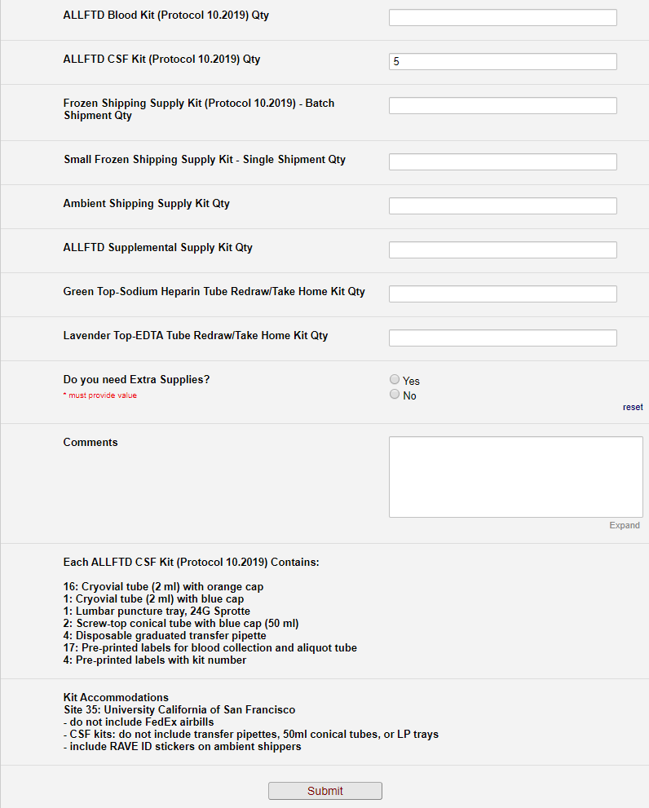
Indicate the quantity needed of each kit
Once selected, kit components of the chosen kit will appear at the bottom of the screen (Pictured)
Click “Submit” to turn in your request.
The IU staff will notify you that your request has been received and address any issues.
**Note: You can order more than one type of kit in a single kit request**

Slide 8
Redraw/Take-Home Kits
Redraw may include:
EDTA tube, or
2 x Sodium Heparin tubes
Sample redraw may occur in one of two ways:
Subject travels to site
Site staff sends participant kit
Drawn with local physician
Cost of draw should be covered by ALLFTD site by direct payment to physician OR reimbursement to participant

Slide 9
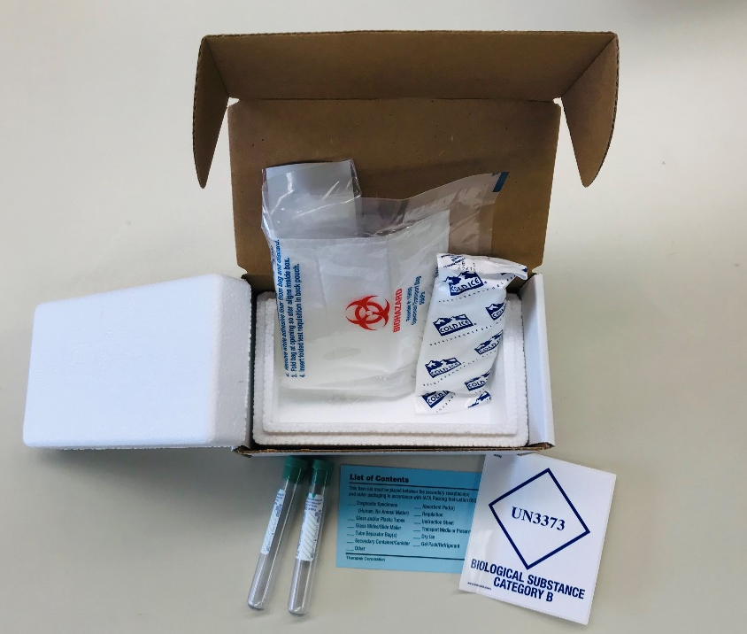
Redraw/Take-Home Kits
DNA Redraw/Take-Home Kit
(1 EDTA Tube)
PBMC REDRAW/TAKE-HOME KIT
(2 PBMC Tubes)

Slide 10
Specimen Labels
Types of labels
How to label tubes

Slide 11
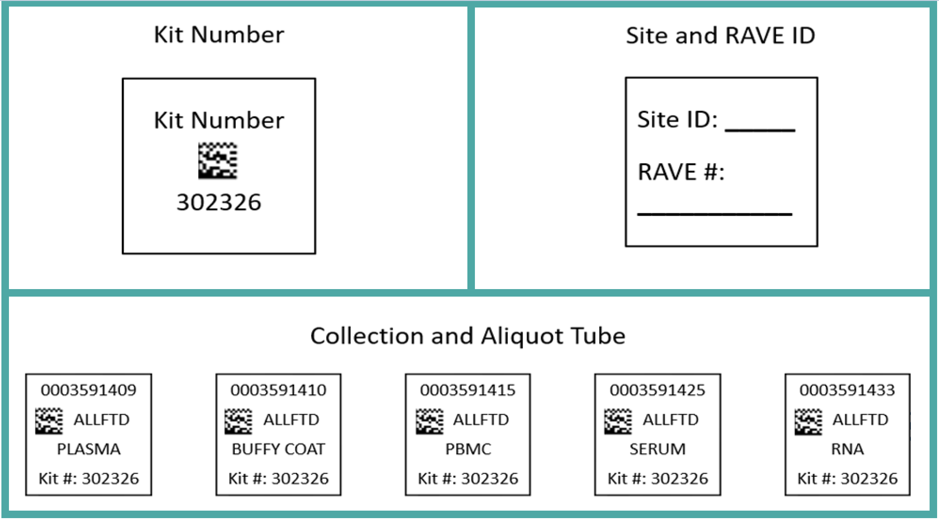
Three Label Types

Slide 12
Kit Number Labels
Used to track patient samples and provide quality assurance – Will be placed on the following locations :
Biological Sample and Shipment Notification Form
(IF COLLECTED) CSF Sample and Shipment Notification Form*
Outside of the biohazard bag that houses the PBMC
Cryobox that houses aliquots during shipping
Outside of the biohazard bag that houses PAXgene™ tubes and aliquot tubes during shipping process
*CSF samples will have a different kit number label than the blood collection specimens
Kit Number
302326

Slide 13
Site and RAVE ID Label
Site ID: _____
RAVE #:
___________
Subjects will be identified by their site ID and RAVE #
The RAVE # may only be available shortly before the visit
Sites will be responsible for handwriting this onto the provided labels
Must use a fine point marker
Write information on label prior to adhering to tube
Will be placed on all collection tubes

Slide 14
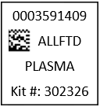
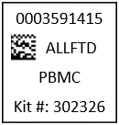
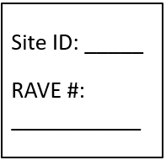
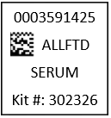
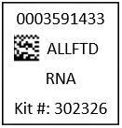
Collection Tubes - Blood
Label 1: Collection Tube Label
Label 2: Site and RAVE ID Label
EDTA Tube
Sodium Heparin Tube
Serum Tube
PAXgene™ Tube
All collection tubes will have two labels: collection tube label and Site and RAVE ID label

Slide 15
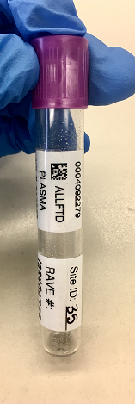
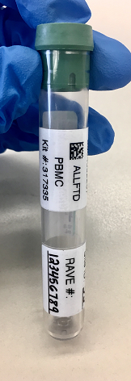
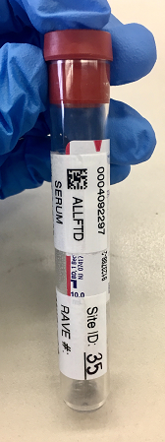
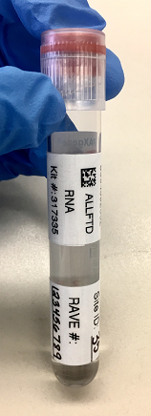
Collection Tubes - Blood
Collection Tube Label
Site and RAVE ID Label
EDTA Tube
Sodium Heparin
Tube
Serum Determination
Tube
PAXgene™
Tube

Slide 16
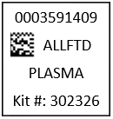
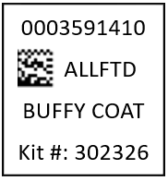
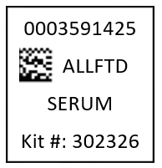
Aliquot Tube Labels
Only one label to be placed on ALL aliquot tubes
Plasma
From EDTA tube
Buffy Coat
From EDTA tube
Serum
Serum Tube
CSF
(Select Patient Population)
Different kit number than blood collection for the same subject at the same visit

Slide 17
Labeling Biologic Samples
Label all collection and aliquot tubes before cooling, collecting, processing or freezing samples
Label only 1 subject’s tubes at a time to avoid mix-ups
Wrap the label around the tube horizontally. Label position is important for all tube types
Make sure the label is completely adhered by rolling between your fingers

Slide 18
Aliquot Tube Labels
Aliquot tube label only
Please place barcode near cap
One label per tube
ALLFTD

Slide 19
Biological Sample and Shipment Notification Forms
“Sample Forms”

Slide 20
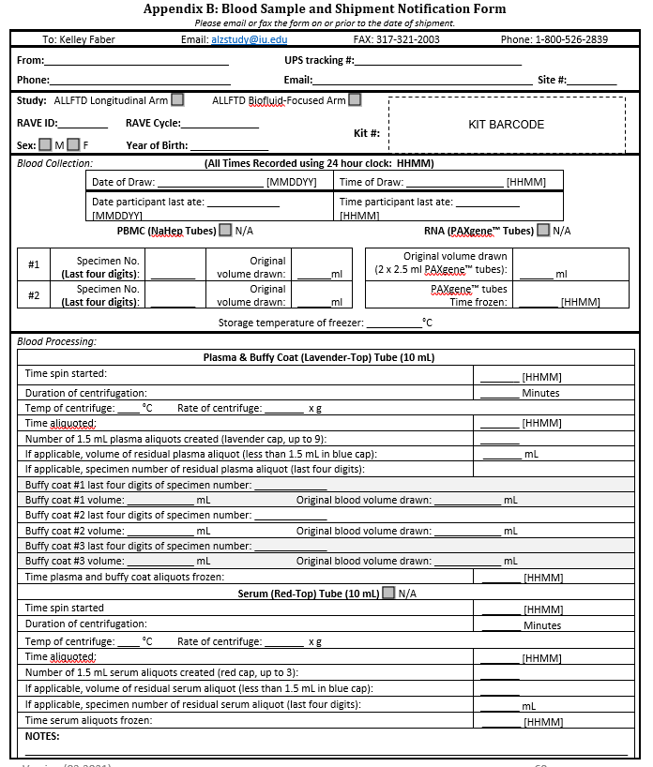
Biological Sample and Shipment Notification Form
(Blood)
Includes expanded blood processing section for both plasma and serum
All aspects of this form must be completed by the study site prior to the samples and sample form being shipped to NCRAD

Slide 21
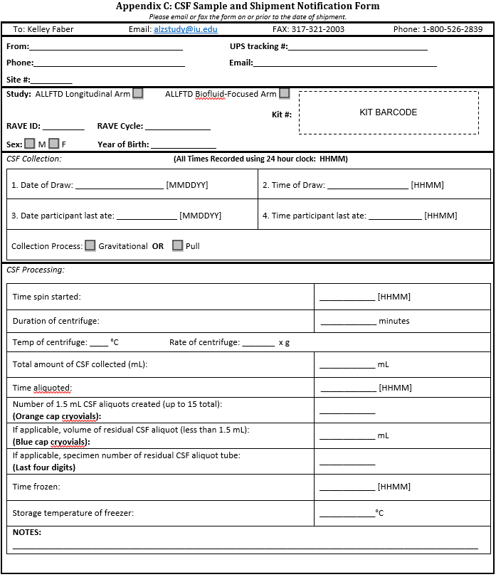
Biological Sample and Shipment Notification Form
(CSF)
Includes expanded CSF processing section
All aspects of this form must be completed by the study site prior to the samples and sample form being shipped to NCRAD

Slide 22
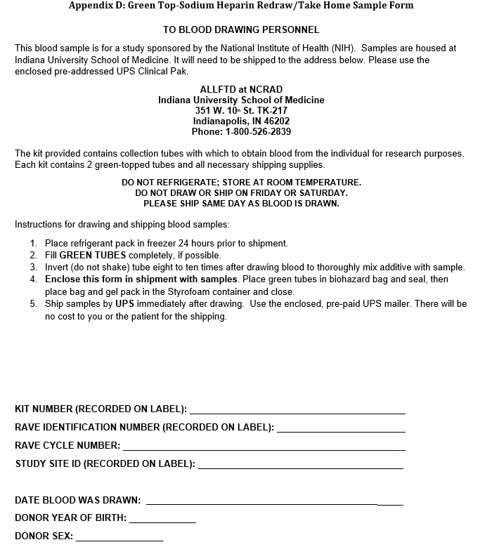
Redraw/Take-Home Sample Form
(PBMC)
Includes collection and shipping directions for local physician
All aspects of this form must be completed by the study site prior to the samples and sample form being shipped to NCRAD

Slide 23
Redraw/Take-Home Sample Form
(DNA)
Includes collection and shipping directions for local physician
All aspects of this form must be completed by the study site prior to the samples and sample form being shipped to NCRAD

Slide 24
Biological Sample and Shipment Notification Forms
A copy of the sample form must be emailed or faxed to NCRAD prior to the date of sample arrival.
Please include sample forms in all shipments of frozen and ambient samples.
Email: alzstudy@iu.edu

Slide 25
Handling/Processing Study Specimens
Draw Order
Collection and aliquoting

Slide 26
Blood Draw Order

Slide 27
Cryovial Cap Colors
Cap Color | Sample Type | Cap Image
Lavender | Plasma
Clear | Buffy Coat
Red | Serum
Orange | CSF
Blue | Residual Aliquot (Plasma, Serum, or CSF)

Slide 28
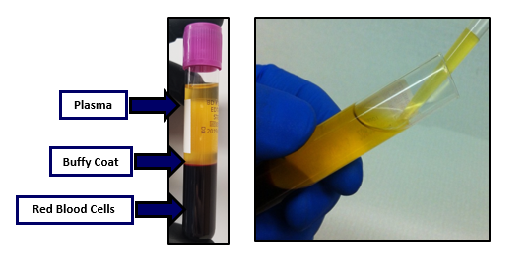
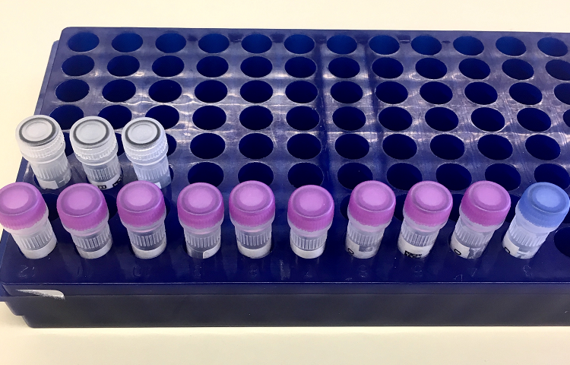
Plasma Collection
3 EDTA tubes will yield approximately 10 plasma aliquots (with 1 residual in blue cap) and 3 buffy coats
Please see the NCRAD tutorial: https://www.ncrad.org/resource/allftd.html

Slide 29
Buffy Coat Collection
Please see the NCRAD tutorial: https://www.ncrad.org/resource/allftd.html

Slide 30
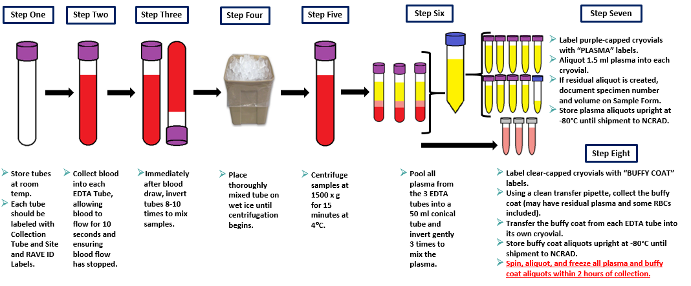
Plasma and Buffy Coat Preparation

Slide 31
PBMC Collection
2 x Sodium heparin (green top) BD Vacutainer® (10 ml)
Not processed at site
*NOTE*: Must be shipped AMBIENT to NCRAD the day sample is drawn.
Only draw and ship Monday through Thursday
No Friday Draws.

Slide 32
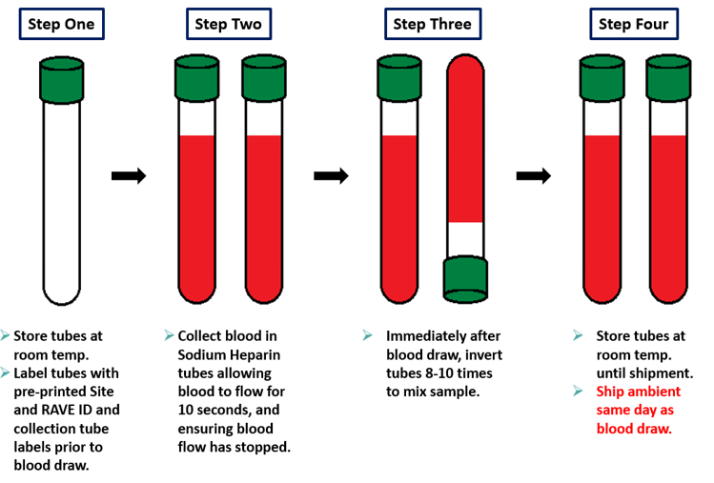
PBMC Preparation

Slide 33
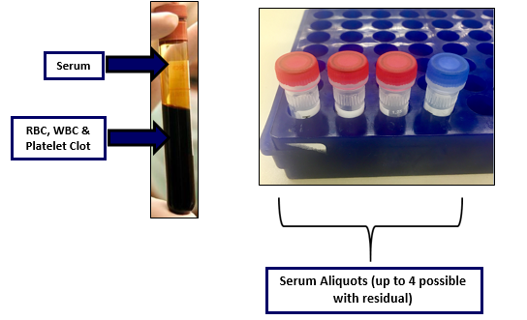
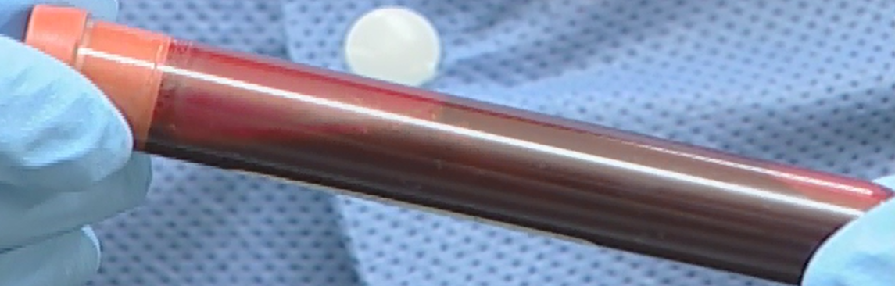
Serum Collection
(Immediately after blood draw – pictured above)
*Please note: After standing at room temperature for 30 minutes, blood will be clotted and immobile**

Slide 34
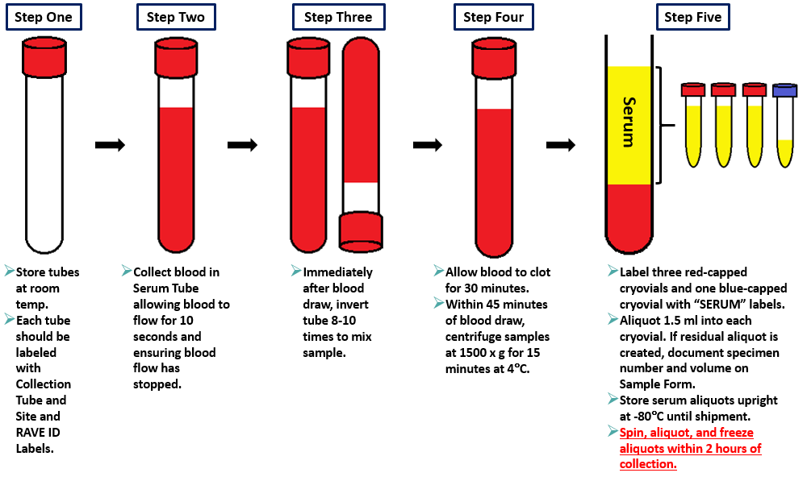
Serum Preparation

Slide 35
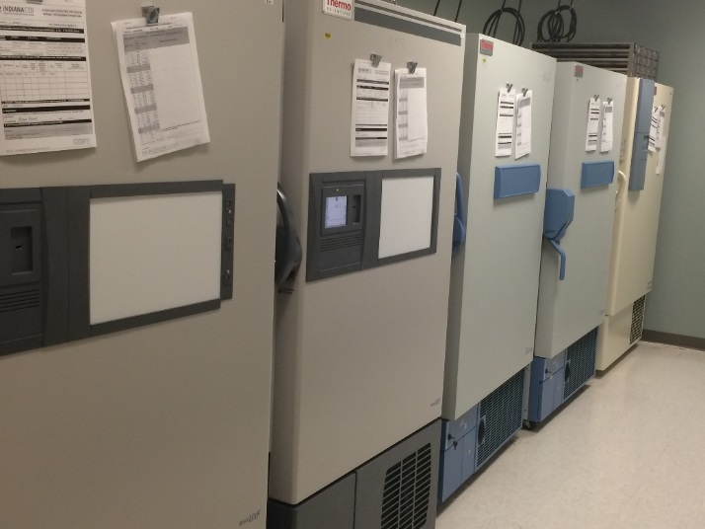
RNA Collection
https://www.youtube.com/watch?v=Ir3dFI6oz3U&feature=youtu.be
Documented within ALLFTD MOP for site staff review
Released by PreAnalytix

Slide 36
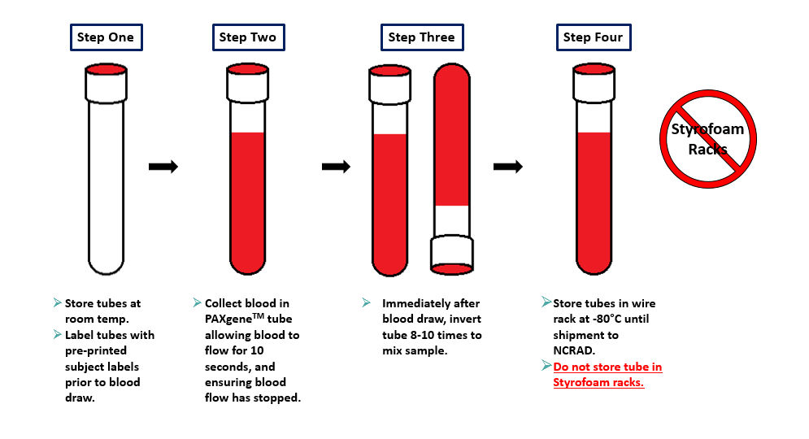
RNA Preparation

Slide 37
CSF Collection and Processing
Select subjects only

Slide 38
Pre-Ice CSF Cryovials
Helpful Tips:
Keep as organized as possible
Pre-label prior to adding cryovials in wet ice
Pre-ice all cryovials included in kit

Slide 39
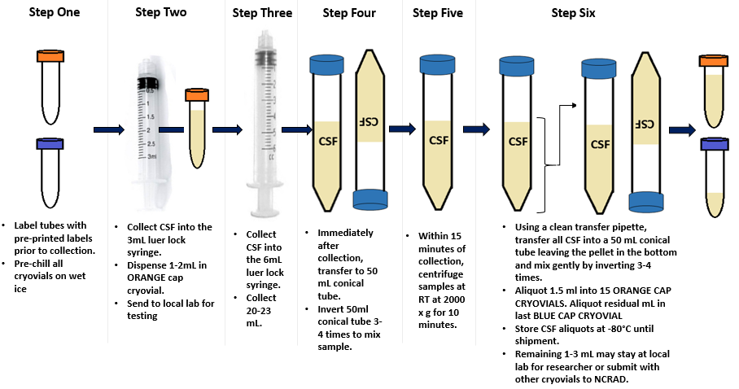
CSF Preparation

Slide 40
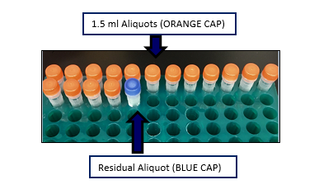
CSF Aliquots
Can collect up to 17 aliquots (including the blue-cap residual)
Freeze vertically in a cryovial rack or 25-cell cryobox
1 extra orange-cap cryovial will be provided without a label. This aliquot will be for local labs
Tutorial: https://www.ncrad.org/resource/allftd.html

Slide 41
Sample Shipments
How to ship samples back to ncrad

Slide 42
Ambient Sample Shipment
Sodium Heparin/PBMC
Only Monday-Thursday collection and same day shipping. Plan ahead to schedule UPS
Samples must be received at NCRAD one day after collection.
Do NOT draw or ship ambient samples on Friday
Include copy of Biological Sample Shipment and Notification Form

Slide 43
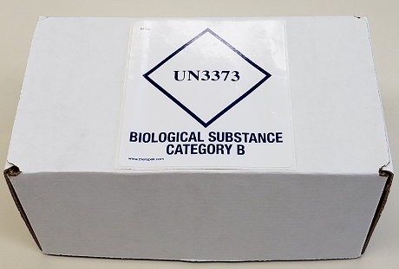
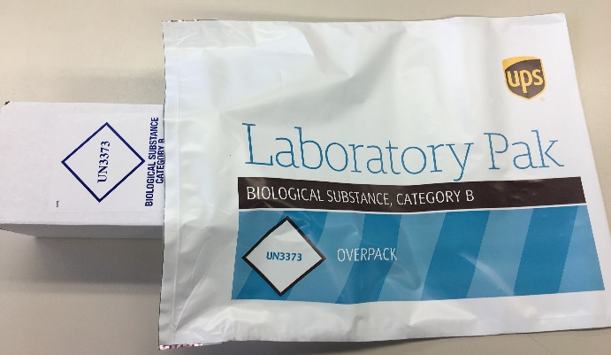
Ambient Shipment Packaging
Place the ambient PBMC tubes in the absorbent slots and biohazard bag.
Place the kit number label on the outside of the biohazard bag.
Place the bag inside the small shipping box, and then set the refrigerant pack on top of it.
Place small shipping box within a provided UPS Clinical Pak, seal, and follow instructions on XXX to create UPS airbill
Note: Gel packs must be put in freezer at minimum the night before shipping

Slide 44
Frozen Batch Sample Shipment
All other samples
Plasma, Buffy Coat, Serum, RNA, and CSF
Ship Monday-Wednesday Only
Hold packaged samples in a -80°C freezer until pickup.
Include copy of Biological Sample Shipment and Notification Form

Slide 45
Frozen Batch Sample Shipment
Blood kit number
CSF kit number
Blood samples
CSF samples
RNA tubes in bubble wrap

Slide 46
Frozen Batch Sample Shipment
Batch shipping should be performed quarterly or when 8 cryoboxes of samples have been collected
Example #1: 4 subjects with blood AND CSF collected (8 total cryoboxes for 4 subjects)
Example #2: 8 subjects with ONLY blood collected (8 total cryoboxes for 8 subjects)
Example #3: 2 subjects with blood AND CSF collected (4 total cryoboxes for 2 subjects) and 4 subjects with ONLY blood collected (4 total cryoboxes for 4 subjects)
*No more than 8 cryoboxes per batch frozen shipment*

Slide 47
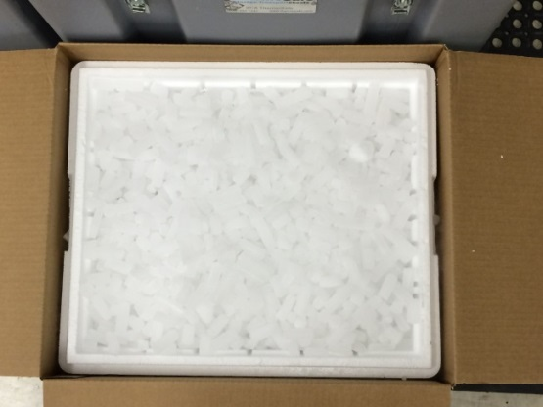
Frozen Batch Sample Shipment
Place 2-3 inches of dry ice in the bottom of the Styrofoam shipping container, then insert the cryoboxes laying upright.
Fully cover the cryoboxes with about 2 inches of dry ice in the provided shipper.
Each Styrofoam shipper must contain about 45 lbs (20 kg) of dry ice.

Slide 48
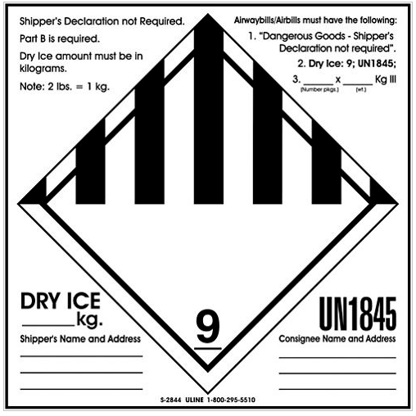
Frozen Batch Sample Shipment
Class 9 Dry Ice label should not be covered with other stickers and must be completed or the shipping carrier will reject/return your package!
Number of packages in shipment and dry ice in kg
Net weight of dry ice in kg
Your name & address
Repository name & address

Slide 49
UPS System
Log into the ShipExec Thin Client at kits.iu.edu/UPS
If a new user or contact needs access, please reach out to your study contact for access
Follow instructions on section 8.3 of ALLFTD Manual of Procedures to create your return airbill and schedule a UPS pickup

Slide 50
NCRAD Website – ALLFTD Page
https://www.ncrad.org/resource/allftd.html
Specimen collection overview
Link to kit request module
Sample forms
MOP
Training Slides

Slide 51
NCRAD Website – Helpful Pages
https://ncrad.org/holiday_closures.html
https://ncrad.org/friday_blood_draws.html

Slide 52
ALLFTD Contact Information
General Information
Phone: 1-800-526-2839
E-mail: alzstudy@iu.edu
Justin Delay– ALLFTD Study Coordinator
E-mail: jndelay@iu.edu
Ariel Quickery – Specialist (Kits)
E-mail: aquicker@iu.edu
Erica Lindsey– Specialist (Data)
E-mail: lindsey2@iu.edu

